Slide 1

Structural Variation
July 16 2018
Danny Antaki

Slide 2
Outline
Introduction
Types of Structural Variation (SV)
Role of SV
Evolution
Human variation
Diseases Attributed to SV
Detection of SV

Slide 3
What is Structural Variation (SV)
Structural Variation is a change of the structure of a chromosome greater than 50bp
Simply: DNA rearrangement
Includes:
Deletions
Duplications
Inversions
Insertions
Translocations
Complex Rearrangements
Classes of Sequence Mutations
SNP: 1bp
INDEL: 2bp-49bp
SV: >50bp
Reference
GATCGATC
GAGCGATC
GAT---GATC
GATGAGGATC
Mutation

Slide 4
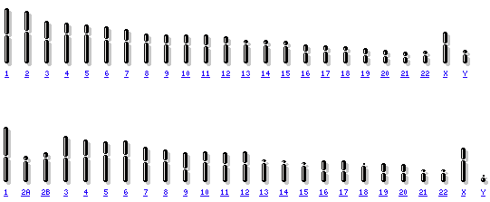
Why study SV?
SV encompass more nucleotides than Single Nucleotide Polymorphisms (SNPs)
360Mb/ ~12% of the human genome can be structurally variable
SV drive evolution
Speciation
Can drastically change phenotype
SV is responsible for many diseases
Autism, Schizophrenia, Cancer …
Chromosome 2 fusion
Human
Chimp

Slide 5
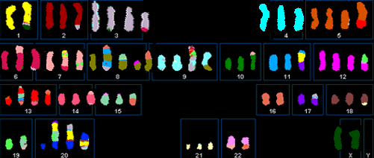
Types of Structural Variation
Copy Number Variation
A copy number change (gain or loss)
Deletion
Duplication
Inversion
DNA reverses end-to-end
Insertions
Addition of DNA
Translocation
Transfer of DNA from one location, to another
Others …
Repeats
Chromothripsis
Breast cancer tumor displaying chromothripsis: “chromosome shattering” and repair

Slide 6
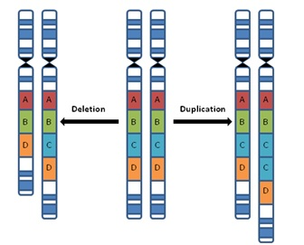
Copy Number Variation
A change in the copy number. Typically either a gain (duplication) or loss (deletion)
Diploid organisms carry how many copies?
Autosomes?:
2 copies
Sex Chromosomes?:
XX = 2 copies of X, 0 of Y
XY = 1 copy of X and Y

Slide 7
Copy Number Variation
Typically a deletion results is a loss of one copy
How many copies for a homozygous deletion?
0
Duplications increase the copy number by one
Not limited to 4 copies.
Homozygous Deletion: 0 copies
Heterozygous Deletion: 1 copy
Homozygous neutral : 2 copies
Heterozygous Duplication : 3 copies
Homozygous Duplication : 4 copies

Slide 8
CNV formation
Non-allelic Homologous Recombination (NAHR)
Unequal crossing over at areas (alleles) of similar homology, but are not the same
Results in a deletion and duplication
A
B
C
Repeats of similar homology
Unequal crossing over
A
B
C
Duplication
A
B
B
C
Deletion
A
C

Slide 9
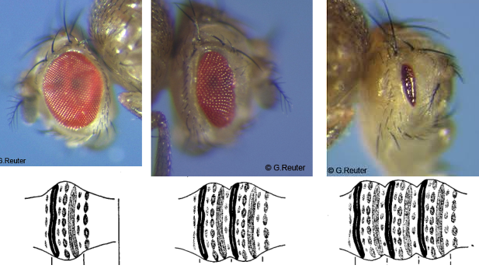
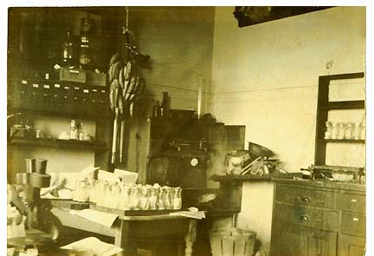
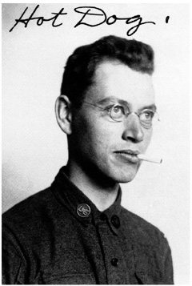
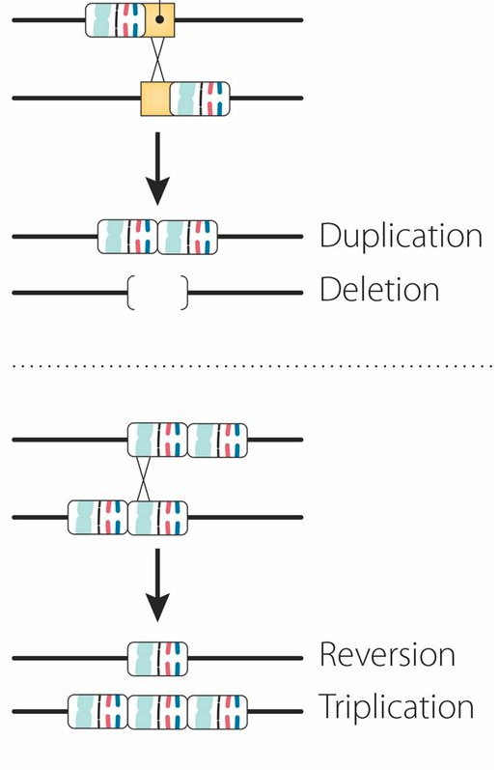
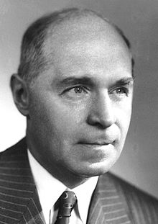
Bar Flies: Discovery of Unequal Crossing Over
1920 Charles Zeleny observed a new mutation that caused bean-shaped eyes in D. melanogaster
He observed children of Bar females tended to revert to the wild-type phenotype
In some cases, offspring had extremely thin eyes: ultra-Bar
1925 Alfred Sturtevant suggested the cause of the phenotypes were unequal crossing over
Wrongly assumed wild type was a deletion
1930 Hermann Muller improved the model and proposed Bar was a duplication and ultra-Bar was a triplication

Slide 10
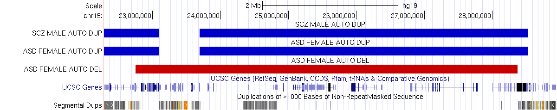
A familiar example: PW/AS Region
Duplications in Schizophrenia
Duplications in Autism
Deletions in Autism
Genes
Repeats of similar homology

Slide 11
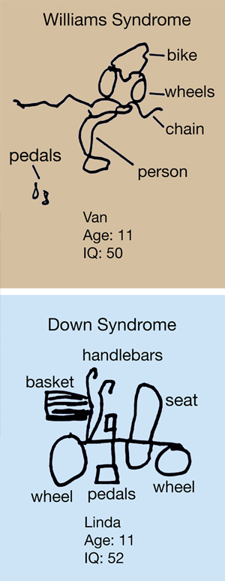
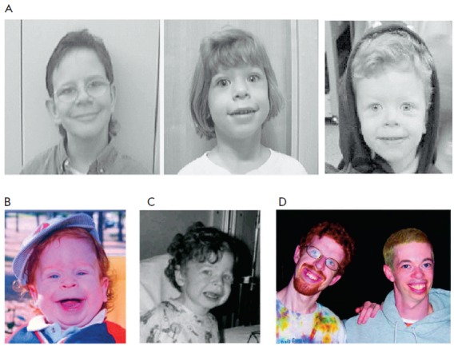
A new example: Williams Syndrome
Affects about 1 in 10,000 births
Caused by a deletion
Symptoms include
Distinctive facial dysmorphia
“Elfin Children”
Low cognitive IQ but high verbal and social IQ
Other development delays

Slide 12
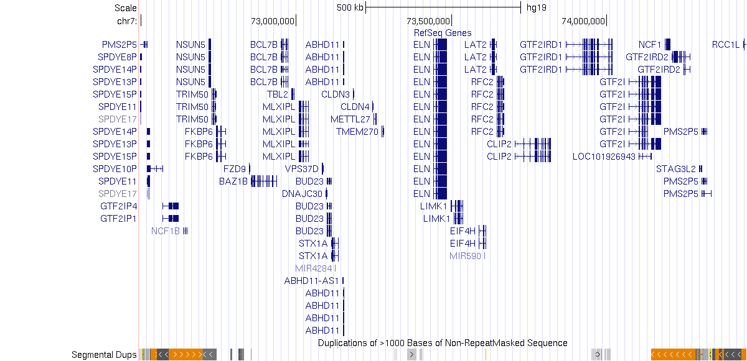
CNVs in the Williams Syndrome Region
1.5Mb region on chr7
ELN and LIMK1
Deletion of this region leads to Williams syndrome
Duplication increases risk for autism
How do CNV arise in this region?
NAHR

Slide 13
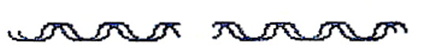
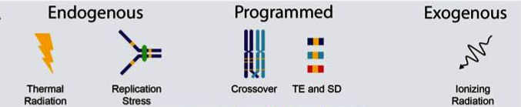
SV formation from double strand breaks
Double strand breaks
Both strands are broken
Causes
Replication stress
Ionizing Radiation (X-rays, Gamma Radiation)
~50 DSB every cell cycle!
Repair
One mechanism:
Non-Homologous End Joining (NHEJ)

Slide 14
Non-Homologous End Joining
NHEJ typically utilizes short homologous DNA sequences called microhomologies to guide repair
Error prone compared to recombination
Uneven matching of microhomologies result in SVs
Deletions, Duplications, and other more complex SVs

Slide 15
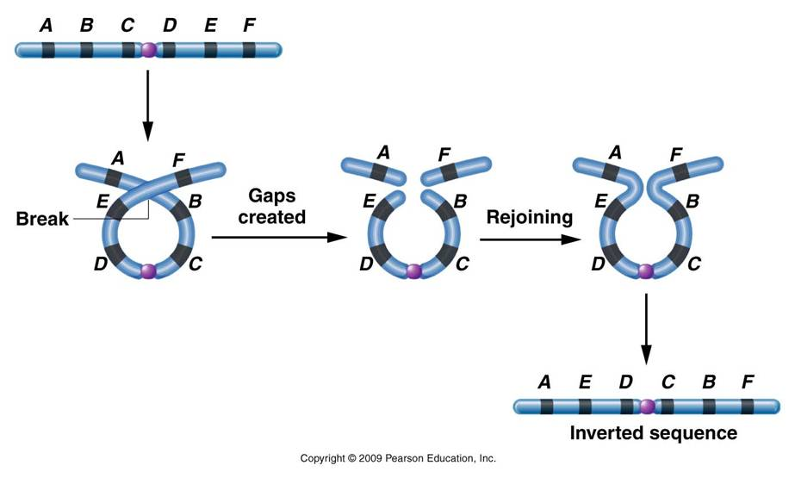
Inversions
DNA reverses end-to-end

Slide 16
Insertion
Addition of DNA
Very common class of insertions: Mobile Elements
Mobile Elements: DNA elements that move around the genome
Transposons
DNA Transposons
Retrotransposons

Slide 17
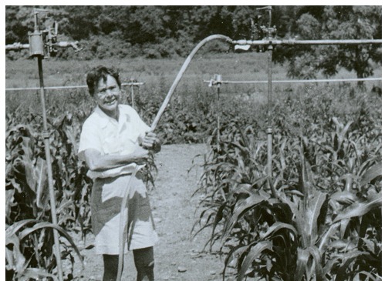
DNA Transposons (insertions)
Replicates and inserts with transposase enzyme
Postulated by Barbra McClintock in the late 1940s
Explained color in Maize
Human DNA Transposons are not active
Once active in primate evolution but stopped ~37 million years ago

Slide 18
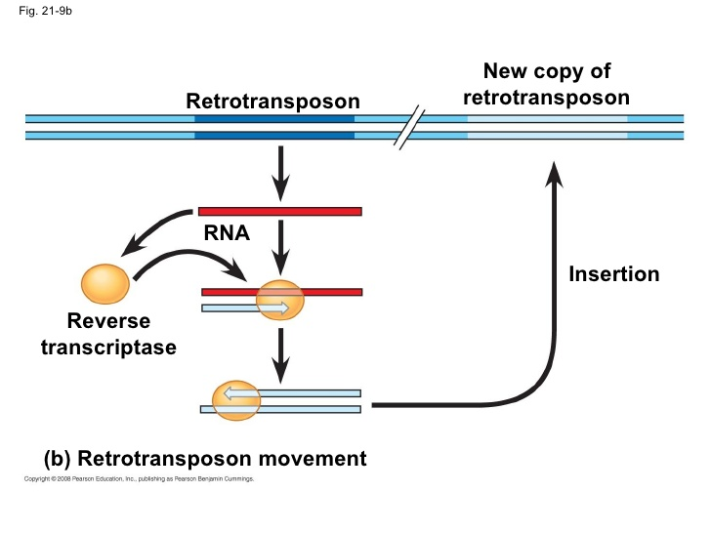
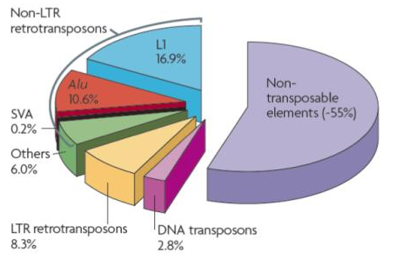
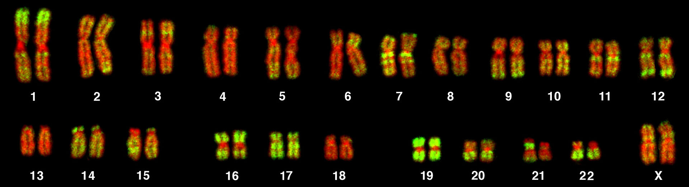
Retrotransposons (insertions)
Copy and paste mechanism using reverse transcriptase
Many originated from viruses that have inserted into the genome
About 42% of the human genome is retrotransposon
Protein coding regions are ~1%
Retrotransposons influence gene expression in many ways
42% of the human genome are retrotransposons
Alu elements stained in green

Slide 19
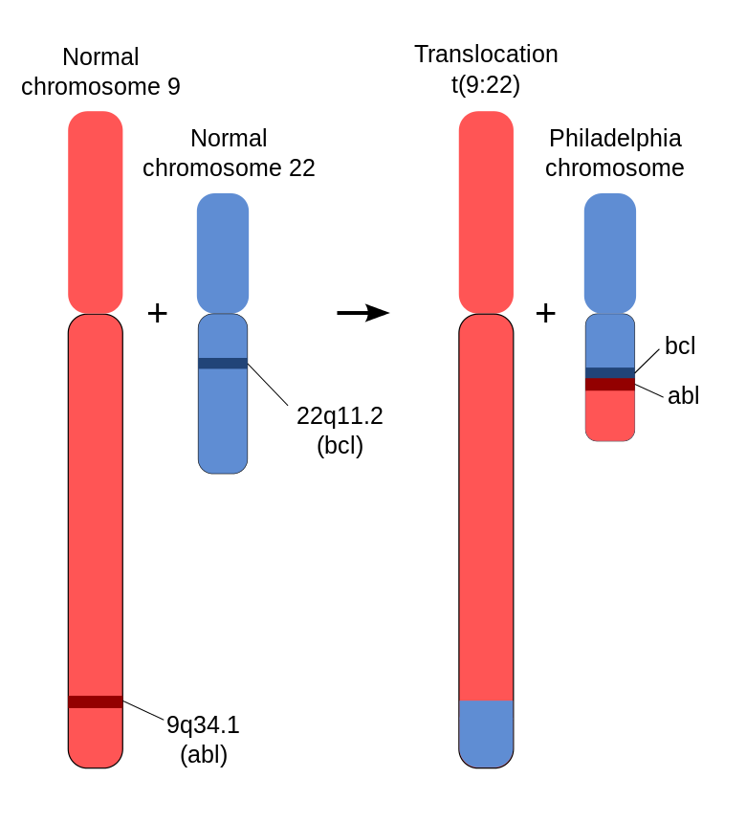
Translocation
Rearrangement of parts of nonhomologous chromosomes
Occurs in ~1:500 individuals, but usually harmless if balanced
Reciprocal Translocation
Balanced: chromosome copy number retained
Robertsonian Translocation
Occurs when two ends of different chromosomes join, resulting in a larger chromosome and a smaller one that is usually discarded
Unbalanced: results in a loss of a chromosome
Hallmark of cancer
Philadelphia chromosome in CML (95% of cases)
Translocation of chromosome 9 and chromosome 22
Creates fusion protein BCR:ABL
Reciprocal translocation of two nonhomologous chromosomes.
Philadelphia chromosome is a translocation of chromosome 9 and 22 resulting in a gene fusion event. The BCR:ABL fusion gene is a target for therapy with the drug Gleevec
Robertsonian Translocation results in a chromosome fusion. The smaller chromosome is usually discarded

Slide 20
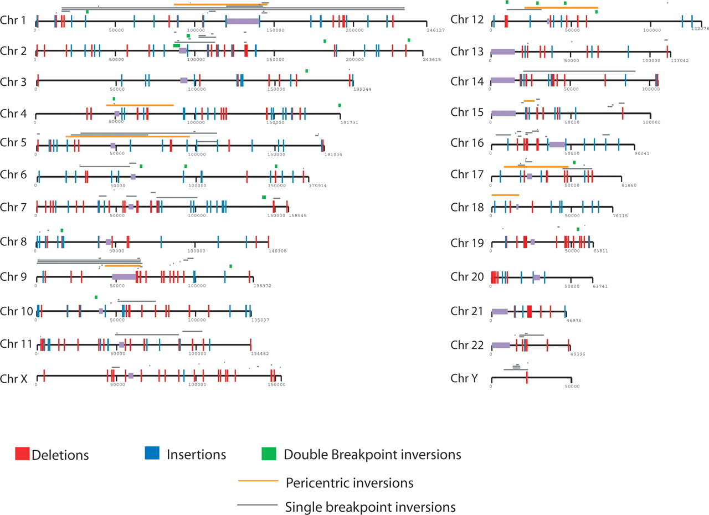
Role of Structural Variation
Structural variation affects more base pairs than single nucleotide changes
New mutations undergo natural selection. Highly beneficial traits can rapidly spread in a population.
Structural Variation differences between Chimp and Human

Slide 21
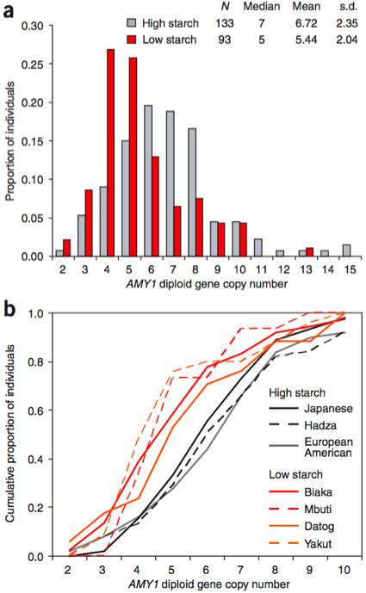
Evolving the ability to digest starch
Salivary amylase gene (AMY1)
Very copy number variable in the human population
Chimps have 2 copies
Most humans have more than 3 copies
People that rely on farming tend to have more copies of AMY1
People that rely on hunting and gathering have fewer copies
The gene encoding salivary amylase is under selection in humans. People that rely more on farming eat more starch and were under a greater selective pressure to evolve more copies of the gene.

Slide 22
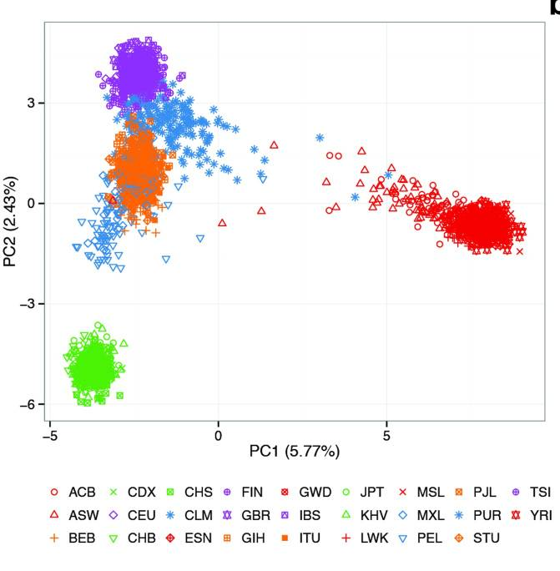
Structural Variation is common
About 6% of each person’s genome is SV
About 13% of the whole human genome is SV
SV can be used to infer ancestry
Clustering of human population using SV. Colors represent major continental groups.

Slide 23
Structural Variation and Disease
Rare structural variation are implicated in many diseases
Autism
Schizophrenia
Heart Disease
Etc…
SV is a hallmark of Cancer cells.
Cancer is a genetic disease
Chromosomal rearrangements are common in cancer

Slide 24
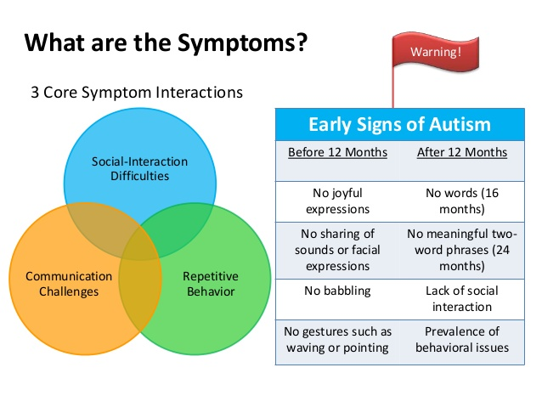
Autism is a disorder of social behavior
Affects about 1 in 100
Heritability estimated to be between 70-90%
Implies strong genetic basis
Currently about 100 genes have been associated with autism

Slide 25
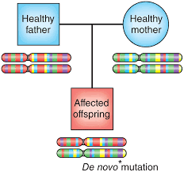
Structural Variation and Autism
Many publications have associated autism to structural variation
Rare SV can remove or duplicate genes causing disease
Additionally de novo SV is a major risk factor in Autism
De novo: new mutations that are found in a child but not the parent
A new mutation originated from the mother is responsible for the disease in the offspring. De novo mutations explain how a genetic disease can occur without previous family history

Slide 26
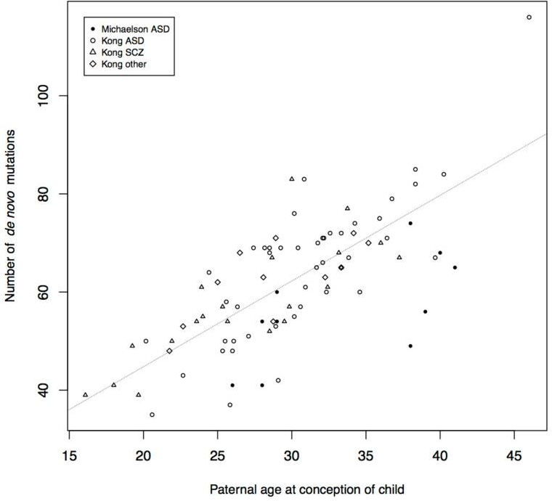
Older fathers and autism
The age of the father is a major risk factor for autism
Every year about 1 new mutation is added
Older fathers increase the chance a new mutation is disease causing
What would be the mechanism for de novo mutations

Slide 27
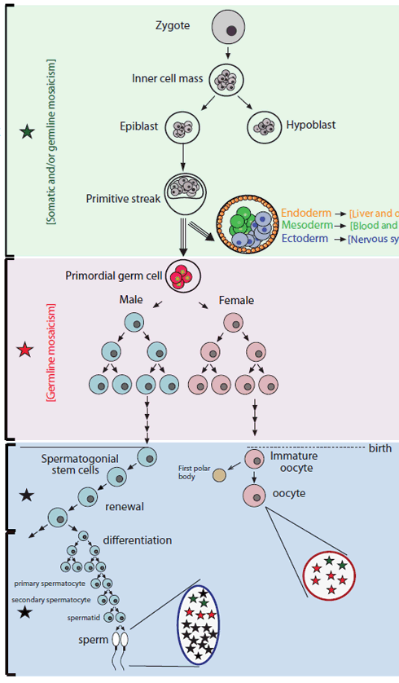
Mutations in Gametes
Most germline mutations in females are established before birth
However older mothers have risk for aneuploidies
Progenitor sperm cells accumulate new mutations as they renew
More mutations accumulate in sperm

Slide 28
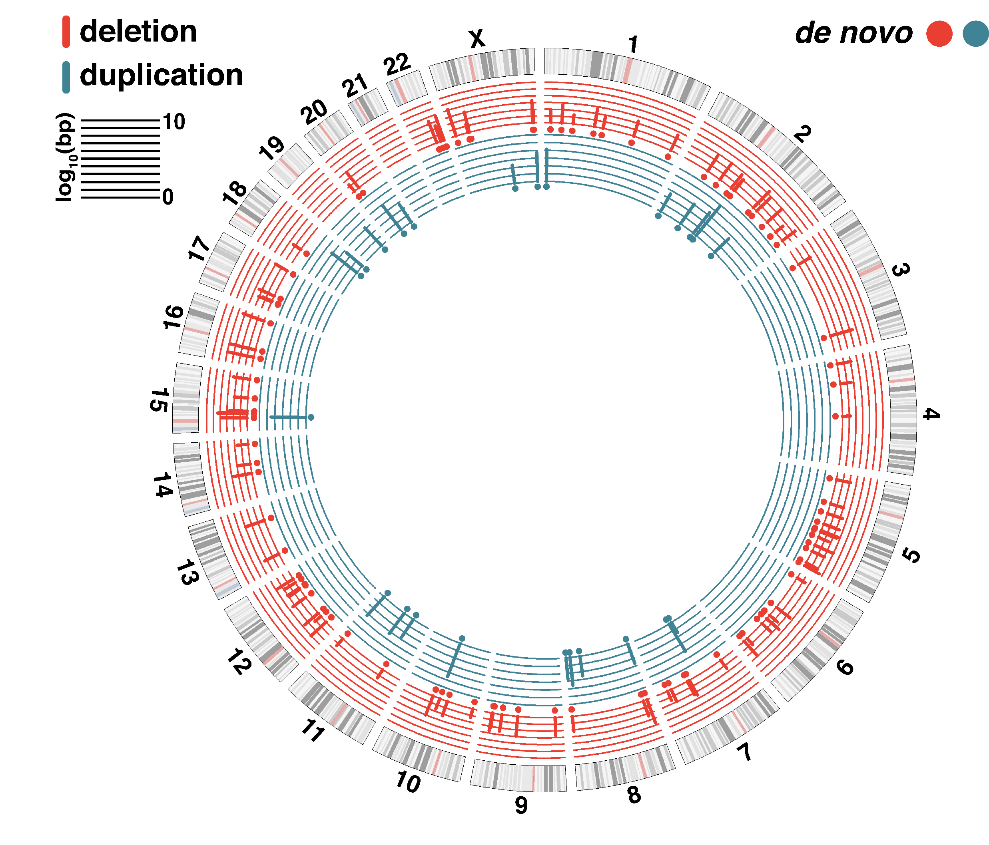
De Novo SV and Autism
De novo SV occur in about 1 in 5 individuals
A de novo SV is not always disease causing
However, autistic children have larger de novo SV which are more likely to hit genes
123 de novo CNVs in 97 offspring from whole genome sequence data. Autistic children have larger de novo SVs

Slide 29
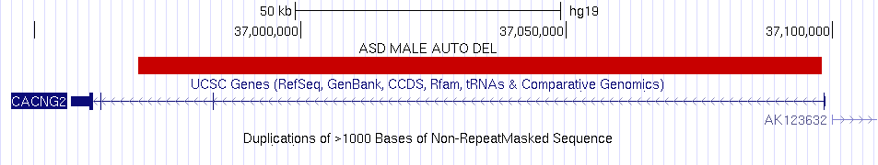
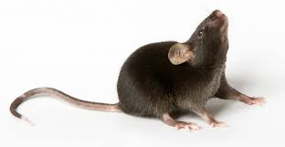
Case Study: Stargazin
128kb de novo deletion in the CACNG2 (stargazing) gene
Gene named after mouse KO, seizures and head nodding
Protein is a calcium ion channel found in synapses
Child has social deficits and behavior issues (aggression)
However has high IQ

Slide 30
Stargazin mouse model
The deletion removes exon 2 of the gene
Exon 2 has 100% identity in mouse
Conserved in evolution
Used CRISPR to make a mouse model of the patient
Human 61 GNFKGLCKQIDHFPEDADYEADTAEYFLR 120
|||||||||||||||||||||||||||||
Mouse 61 GNFKGLCKQIDHFPEDADYEADTAEYFLR 120

Slide 31
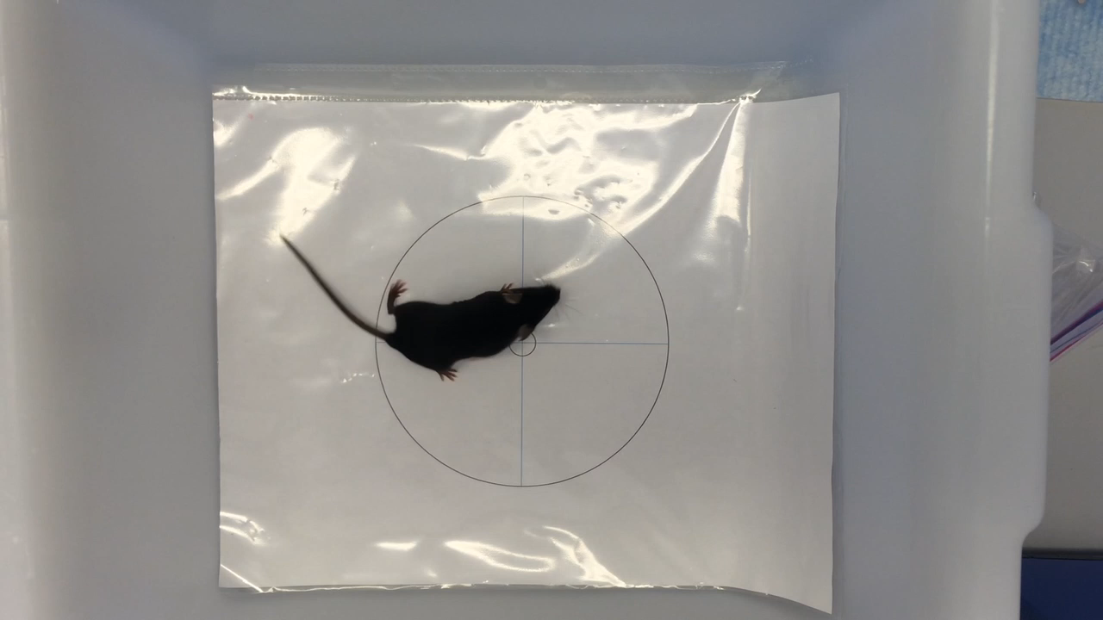
Stargazin mouse model has repetitive phenotype

Slide 32
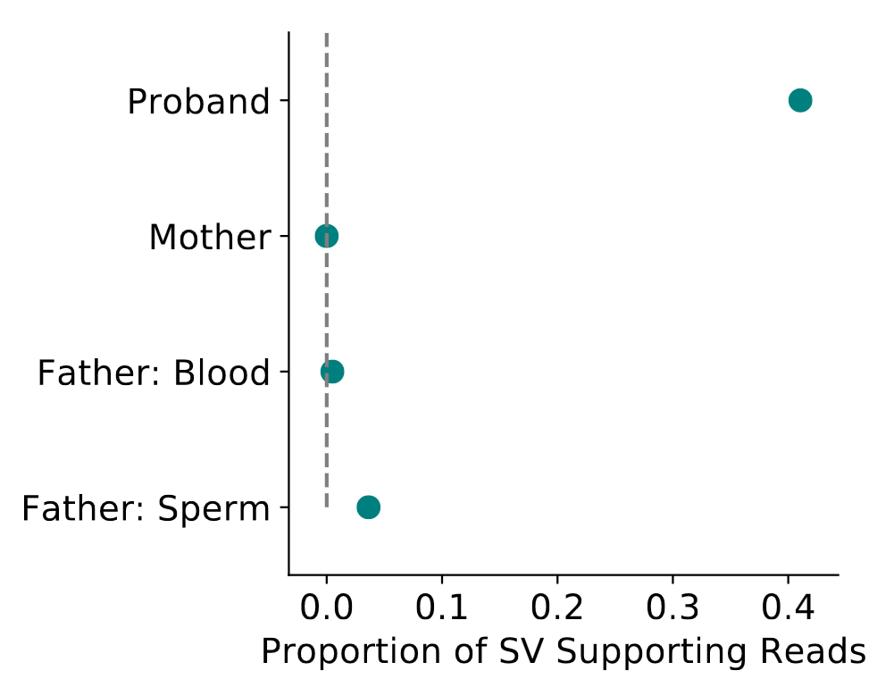
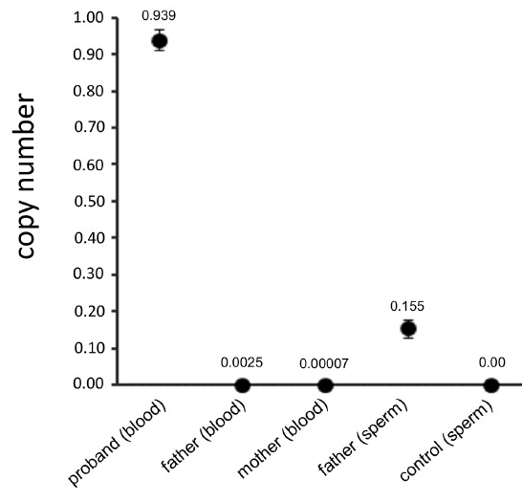
Mutation is present in father’s sperm
About 7-10% of the father’s sperm has the CACNG2 mutation
Less than 1% of the father’s somatic cells (blood) has the mutation
What is this genetic phenomena called?
Mosaicism

Slide 33
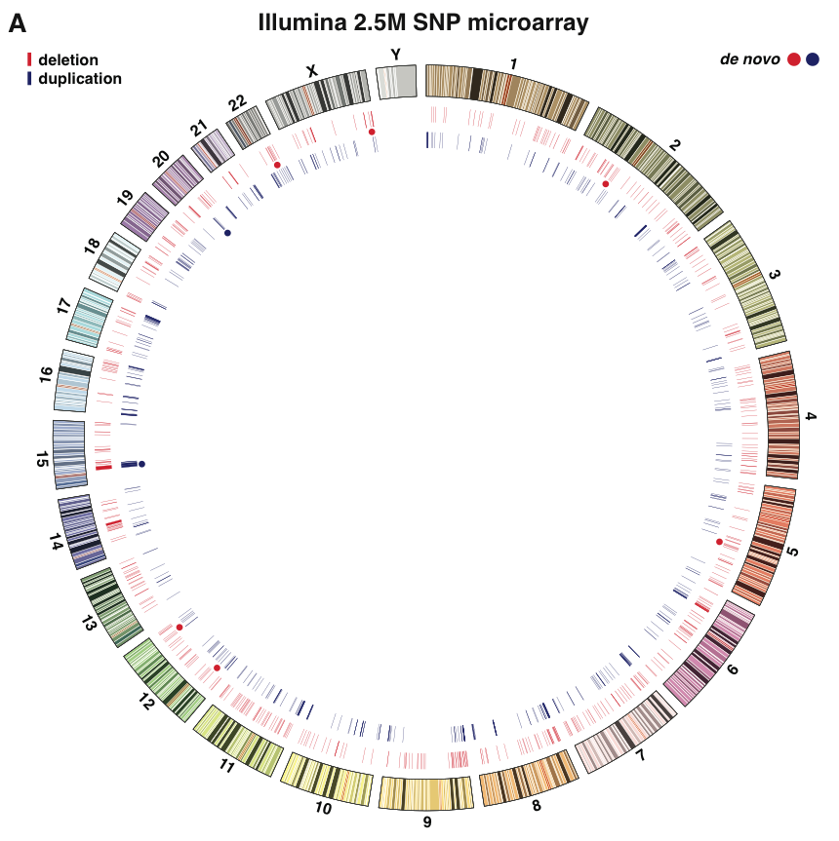
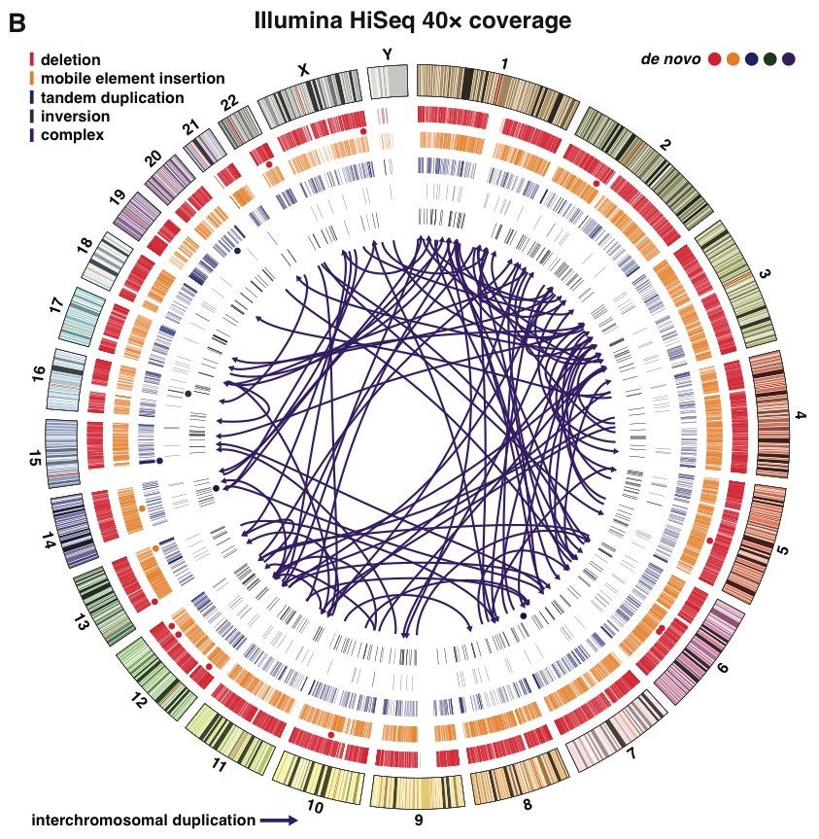
Detecting Structural Variation
Cytogenetics
Good for large scale SV (typically larger than 1Mb)
Karyotyping
FISH
Microarrays
Very popular 10 years ago, but still used
Can detect Deletions and Duplications
Cannot detect Inversions, Insertions, or other complex breaks
Good for SV larger than 20,000bp
Sequencing
Next Generation Sequencing (paired-end)
3rd Generation Sequencing (long-reads)

Slide 34
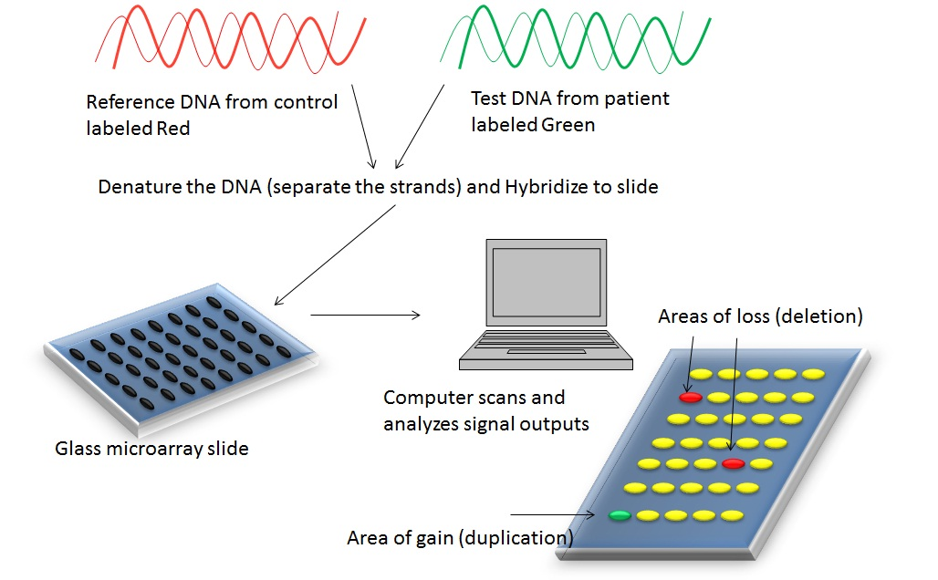
Microarrays
Probes about 500k-2M points in the genome
Advantages:
Cheap (< $100)
Can process more samples
Disadvantages
Only look for gains or losses
Areas outside of probes are not tested
Approximate breakpoints

Slide 35
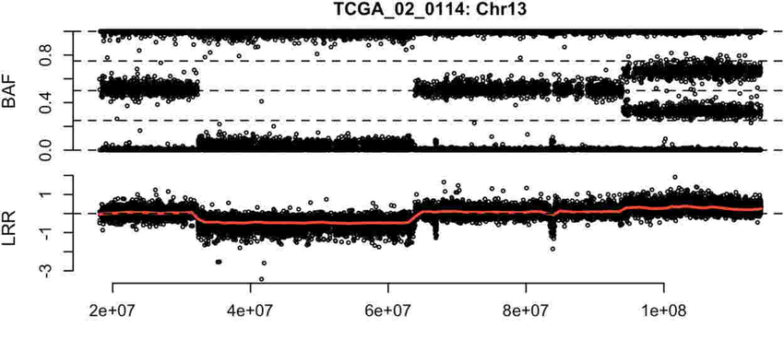
Microarray data
Duplication
Deletion
B-allele Frequency (BAF) is the ratio of signal intensity of one allele to another. Log-R-Ratio is a normalized measure of signal intensity. For deletions LRR is lowered; duplications have higher LRR.

Slide 36
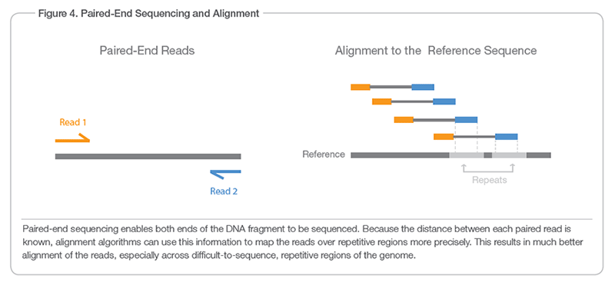
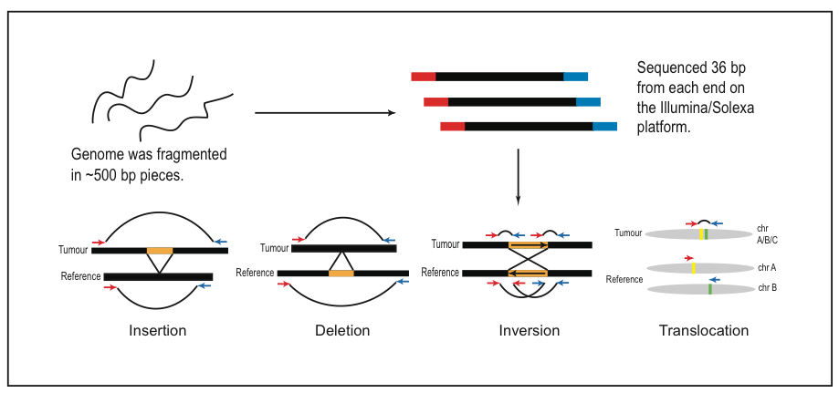
Sequencing Data
Next Generation Sequencing
Paired-End, Short Read data
Advantages:
Comprehensive
Low Error Rates
Costs lowering (~$750 per person)
Disadvantages:
Reads are too short (150bp) to map to repetitive regions
Data Storage (each genome ~250Gb )
Both Read 1 and Read 2 were sequenced from the same DNA fragment. However, Read 1 is on the forward strand and Read 2 is on the reverse strand
Paired-End reads spanning inversion breakpoints have mate pairs on the same strand when mapped to the reference genome

Slide 37
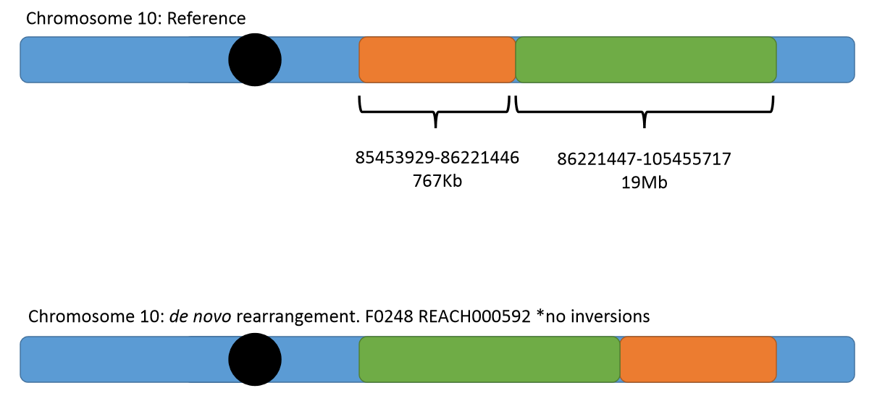
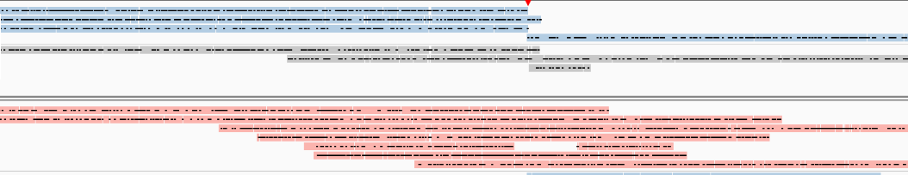
3rd Generation of Sequencing
Long-Read Sequencing
Reads from 500bp-20,000bp
PacBio, Oxford Nanopore
Advantages
Longer reads
better mapping in repeat regions
Phasing of read
Disadvantages
Very new with little tools for analysis
High error rates
Long reads in blue are from the father’s haplotype for the first breakpoint. The mother’s haplotype is in red. The SV originated from the father

Slide 38
Questions?
github.com/dantaki/presentations/tree/master/BICD100/

Slide 39
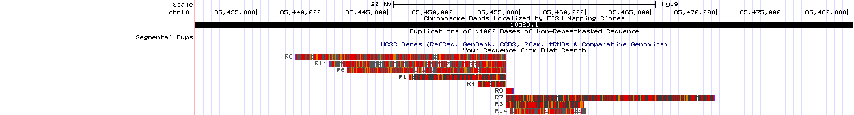
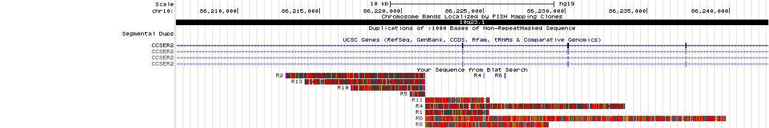
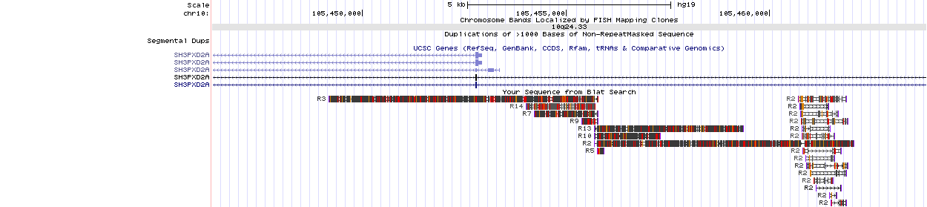
Break 1
B1L: 1,4,6,8,11
B1R: 3,7,9,14
Break 2
B2L: 2,5,10,13
B2R: 1,4,6,8,11
Break 3
B3L: 3,7,9,14
B3R: 2,5,10,13

